Slide 1




TB Preventive Treatment
Salome Charalambous
The Aurum Institute
22 July 2019

Slide 2
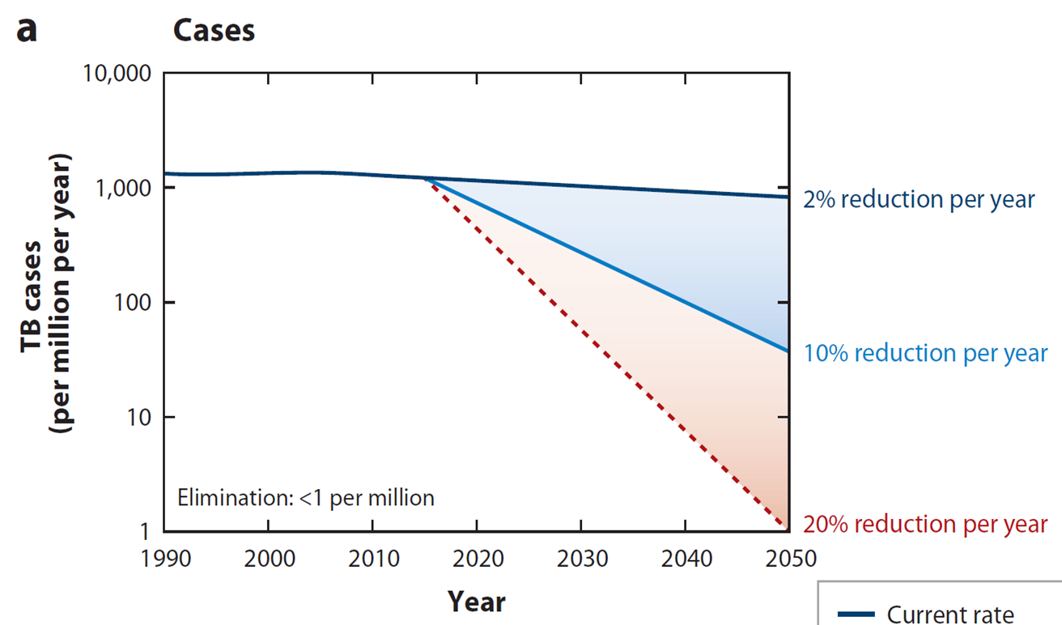
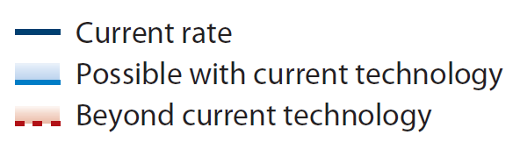
TB Incidence Predictions
Dye, Annual Review of Public Health, 2013

Slide 3
WHO End TB Strategy
Patient centred care & prevention
Pillar 1
Early diagnosis of TB
Collaborative TB/HIV activities
Preventive treatment for those at high risk of TB
Treatment of all people with TB

Slide 4
Prospects for ending TB in S. Africa
(TB incidence, 2013: 860/100,000)
60% protected by 2030
A Reid, Int J. Tuberc Lung Dis. 2015.

Slide 5
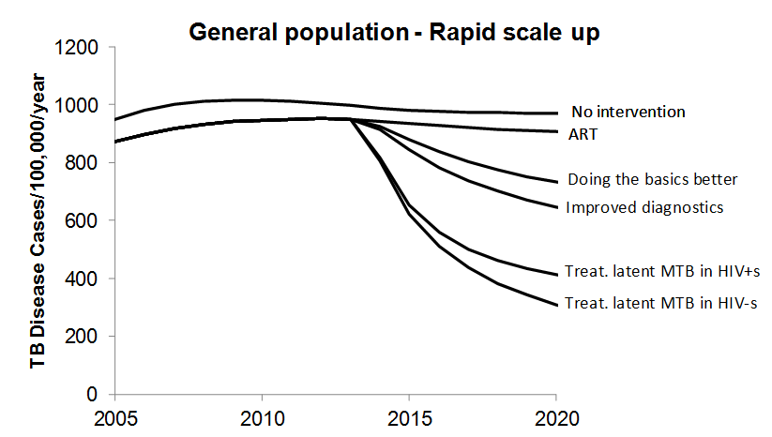
Prospects for ending TB in S. Africa
(TB incidence, 2013: 860/100,000)
60% protected by 2018
A Reid, Int J. Tuberc Lung Dis. 2015.

Slide 6
Released in 2018
Recommendations cover:
Daily INH for 6 months
Daily INH for 36 months
3HP: Rifapentine plus isoniazid weekly for 3 months - New
3HR: Rifampicin plus isoniazid daily for 3 months for children and adolescents < 15y- New
Caution: Potential drug–drug interactions in rifampicin- and rifapentine-containing TPT for PLHIV on some ART regimens
Notes:
Is there a word missing in the ‘caution’ section?

Slide 7
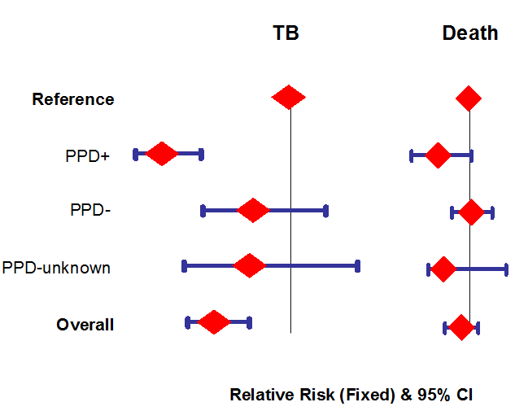
Daily IPT (6m or 12m)
1.0
1.0
0.36
0.74
0.86
1.02
0.86
0.81
0.67
0.95
Akolo. 2010, Cochrane review

Slide 8
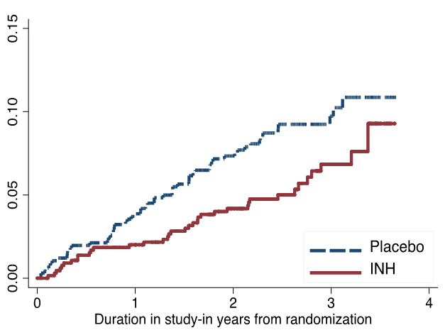
IPT with ART
HR:0.63 (95% CI 0.41-0.94)
Cumulative TB incidence
TB incidence
Rangaka et al, AIDS2012

Slide 9
IPT is cheap and effective, yet IPT uptake in high burden settings remains low
IPT uptake¹ among PLHIV²
Barriers to IPT uptake
Number of people living with HIV (‘000)
WHO GLOBAL TB REPORT
Notes:
67 of 200 countries reported on TB PT (WHO report)
Among countries that reported IPT usage, coverage for child contacts <5 and PLHIV was 23% and 36% respectively

Slide 10
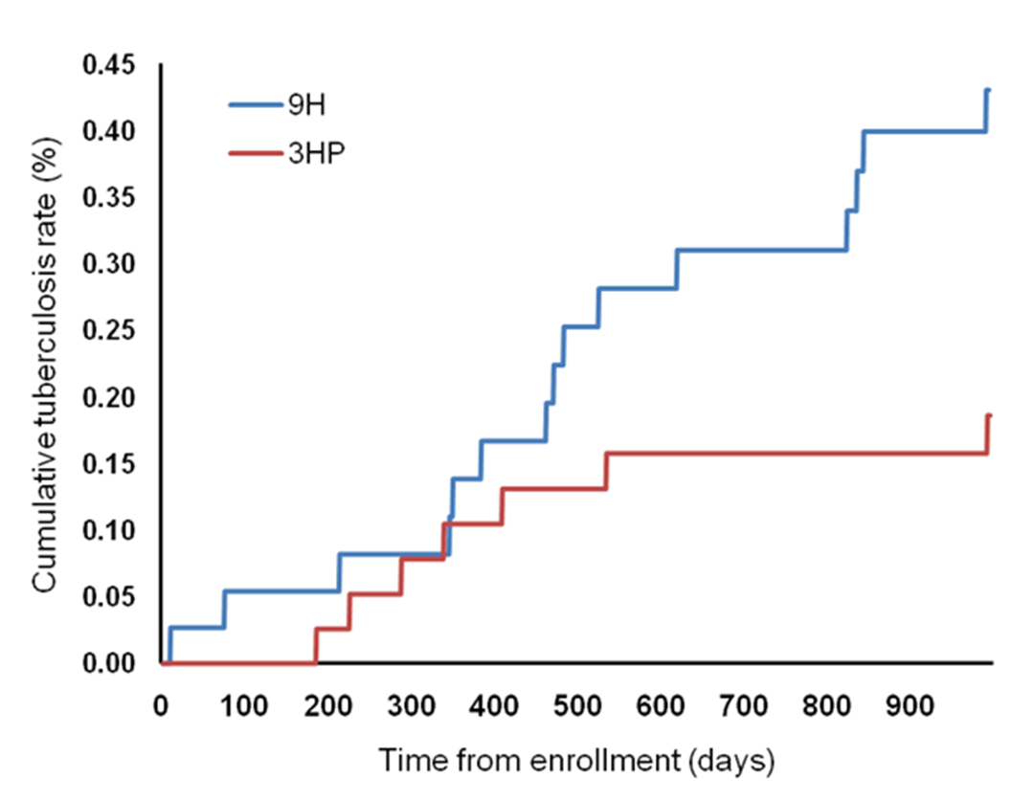
PREVENT TB: 3HP
TBTC Study 26: TST converters in US, Canada, Brazil & Spain
Treatment completion: 82% vs. 69%
Treatment limiting AEs: 4.9% vs. 3.7%
Hepatotoxicity: 0.4% vs. 2.7%
MITT analysis: TB event rate 0.13% vs 0.32%
Sterling NEJM 2011;365:2155

Slide 11
Other Regimens
4R: Rifampicin x 4 months¹: 3443 (7732 years follow up) 4R group vs 3416 (7652 years follow up) in 9H group in 9 countries
  Similar efficacy
  Treatment completion: 78.8% vs 63.2%
  Treatment stopped due to adverse events: 2.2% vs 4.8%
3HR: evidence from low incidence settings
  Similar efficacy and safety to 3HP
  Recommended for children and adolescents – can be given to children < 2years
¹Menzies D, et al: New Eng J Med 2018, 379(5):440-453;

Slide 12
Multicentre, RCT, 3000 individuals ± 1100 from SA and Botswana
TB incidence: 33/4897 (0.67%) vs. 32/4926 (0.65%)
Adverse events and treatment completion
Daily Rifapentine INH x 1 month (1HP): BRIEF TB
Serious adverse events: 6% (1HP) vs 7% (9H) group (P = 0.07)
Incidence of adverse events: 0.029 (1HP) vs 0.047 (9H) per 100 per years, IRR 1.587
Treatment completion: 97% (1HP) vs 90% (9H), P < 0.001
Swindells S, N Engl J Med. 2019 Mar 14;380(11)

Slide 13
3HP Post marketing surveillance
Centers for Disease Control and Prevention
After CDC guidelines on 3HP published in 2011
16 sites across the U.S.—operational settings
  Rifapentine currently available only in the U.S.
2011 - 2016
3,288 persons started 3HP and were eligible to complete treatment during study period
  2,861 (87%) completed treatment
    Children age 2-17 years: 155/164 (94.5%)
    Homeless: 81% completion
  Adverse event rates similar to the PREVENT TB study
Sandul, CID, 2017
Notes:
Clin Infect Dis. 2017 Oct 1;65(7):1085-1093. doi: 10.1093/cid/cix505.
High Rate of Treatment Completion in Program Settings With 12-Dose Weekly Isoniazid and Rifapentine for Latent Mycobacterium tuberculosis Infection.
Sandul AL¹, Nwana N¹, Holcombe JM², Lobato MN^{1,3}, Marks S¹, Webb R^{2,4}, Wang SH⁵, Stewart B¹, Griffin P⁶, Hunt G⁷, Shah N^{1,8}, Marco A⁹, Patil N⁹, Mukasa L⁹, Moro RN¹, Jereb J¹, Mase S¹, Chorba T¹, Bamrah-Morris S¹, Ho CS¹.
Author information
1Division of Tuberculosis Elimination, National Center for HIV/AIDS, Viral Hepatitis, STD, and TB Prevention, Centers for Disease Control and Prevention, Atlanta, Georgia.2Mississippi State Department of Health, Jackson.3Connecticut Department of Public Health, Hartford.4University of Mississippi Medical Center, Jackson.5Ohio State University Medical Center, Columbus.6Kansas Department of Health and Environment, Topeka.7Nationwide Children's Hospital, Columbus, Ohio.8California Department of Public Health, San Francisco ; and.9Arkansas Department of Health, Little Rock.
Abstract
Background:
Randomized controlled trials have demonstrated that the newest latent tuberculosis (LTBI) regimen, 12 weekly doses of directly observed isoniazid and rifapentine (3HP), is as efficacious as 9 months of isoniazid, with a greater completion rate (82% vs 69%); however, 3HP has not been assessed in routine healthcare settings.
Methods:
Observational cohort of LTBI patients receiving 3HP through 16 US programs was used to assess treatment completion, adverse drug reactions, and factors associated with treatment discontinuation.
Results:
Of 3288 patients eligible to complete 3HP, 2867 (87.2%) completed treatment. Children aged 2-17 years had the highest completion rate (94.5% [155/164]). Patients reporting homelessness had a completion rate of 81.2% (147/181). In univariable analyses, discontinuation was lowest among children (relative risk [RR], 0.44 [95% confidence interval {CI}, .23-.85]; P = .014), and highest in persons aged ≥65 years (RR, 1.72 [95% CI, 1.25-2.35]; P < .001). In multivariable analyses, discontinuation was lowest among contacts of patients with tuberculosis (TB) disease (adjusted RR [ARR], 0.68 [95% CI, .52-.89]; P = .005) and students (ARR, 0.45 [95% CI, .21-.98]; P = .044), and highest with incarceration (ARR, 1.43 [95% CI, 1.08-1.89]; P = .013) and homelessness (ARR, 1.72 [95% CI, 1.25-2.39]; P = .001). Adverse drug reactions were reported by 1174 (35.7%) patients, of whom 891 (76.0%) completed treatment.
Conclusions:
Completion of 3HP in routine healthcare settings was greater overall than rates reported from clinical trials, and greater than historically observed using other regimens among reportedly nonadherent populations. Widespread use of 3HP for LTBI treatment could accelerate elimination of TB disease in the United States.

Slide 14
3HP vs other regimens: systematic review
15 studies published b/w Jan 2006–Jun 2017
Similar effectiveness: OR: 0.89 (0.46, 1.70)
Higher Treatment completion rates: (87.5% (83.2%-91.3%) vs 65.9% (53.5%- 77.3%)
  Similar for DOT vs SAT : 86.6% (81.3%-91.1%) vs 81.9% (73.8%-88.9%)
Similar risk of
  Adverse events (RR 0.59 (0.23-1.52))
  Discontinuing treatment because of adverse events (RR 0.48 (0.17-1.34)
  Death (RR 0.79, (0.56-1.11))
Njie, Am J Prev Med. 2018
Notes:
CONTEXT:
Latent tuberculosis infection diagnosis and treatment is a strategic priority for eliminating tuberculosis in the U.S. The Centers for Disease Control and Prevention has recommended the short-course regimen of 3-month isoniazid-rifapentine administered by directly observed therapy. However, longer-duration regimens remain the most widely prescribed latent tuberculosis infection treatments. Limitation on adoption of 3-month isoniazid-rifapentine in the U.S. might be because of patients' preference for self-administered therapy, providers' lack of familiarity with 3-month isoniazid-rifapentine, or lack of resources to support directly observed therapy. This review examines the most recent evidence regarding 3-month isoniazid-rifapentine's effectiveness, safety, and treatment completion when directly compared with other latent tuberculosis infection regimens primarily comprising 9-month isoniazid treatment.
EVIDENCE ACQUISITION:
Using Community Guide methodology, reviewers identified, evaluated, and summarized available evidence published during January 2006-June 2017. Analysis of the data was completed in 2017.
EVIDENCE SYNTHESIS:
The analysis included 15 unique studies. Three-month isoniazid-rifapentine was determined to be equal to other latent tuberculosis infection regimens in effectiveness (OR=0.89, 95% CI=0.46, 1.70), and has higher treatment completion (87.5%, 95% CI=83.2%, 91.3%) compared with other latent tuberculosis infection regimens (65.9%, 95% CI=53.5%, 77.3%). Three-month isoniazid-rifapentine was associated with similar risk to other latent tuberculosis infection regimens for adverse events (relative risk=0.59, 95% CI=0.23, 1.52); discontinuing treatment because of adverse events (relative risk=0.48, 95% CI=0.17, 1.34); and death (relative risk=0.79, 95% CI=0.56, 1.11).
CONCLUSIONS:
The 3-month isoniazid-rifapentine regimen is as safe and effective as other recommended latent tuberculosis infection regimens and achieves significantly higher treatment completion rates.

Slide 15
Safety of 3HP: a systematic review
23 RCTs & 55 non-randomised studies
Rate of any AE: 3HP (11.5%), 3-4R (20.%), 6H (36.1%), 9H (17.6%)
Withdrawals due to AEs: 3HP (1.7%) vs 9H (6.4%), 6H (3.8%)
Flu like reactions: 3HP (2.2%) vs INH (0.05%)
Hepatotoxicity: 3HP (1%), 3-4R (0.01%), 6H (6.3%), 9H (3.1%)
Pease. Pharmacoepidemiol Drug Saf. 2018
Notes:
A systematic review of adverse events of rifapentine and isoniazid compared to other treatments for latent tuberculosis infection.
Pease C¹, Hutton B^{2,3}, Yazdi F², Wolfe D², Hamel C², Barbeau P², Skidmore B², Alvarez GG^{1,2,4}.
Author information
1Ottawa Hospital, Ottawa, Canada.2Ottawa Hospital Research Institute, Ottawa, Canada.3Public Health and Preventive Medicine, Ottawa University School of Epidemiology, Ottawa, Canada.4Ottawa University Faculty of Medicine, Ottawa, Canada.
Abstract
PURPOSE:
Tuberculosis (TB) remains a common cause of death globally. A regimen of 12 doses of isoniazid (INH) and rifapentine given once weekly (INH/RPT-3) has recently been recommended by the World Health Organization for the treatment of latent TB infection (LTBI). We aimed to determine whether the INH/RPT-3 regimen had similar or lesser rates of adverse events compared to other LTBI regimens, namely INH for 9 months, INH for 6 months, rifampin for 3 to 4 months, and rifampin plus INH for 3 to 4 months.
METHODS:
We searched MEDLINE, Embase, CENTRAL, PubMed, ICTRP, clinicaltrials.gov, and Canadian Agency for Drugs and Technologies in Health's Gray Matters Light for randomized, postmarketing, and comparative nonrandomized studies of patients with confirmed LTBI that reported the frequency of at least 1 adverse event of relevance for a regimen of interest. The search included studies published until March 2017. The frequencies of adverse events were extracted and are presented descriptively.
RESULTS:
Data from 23 randomized and 55 nonrandomized studies were included. Although inconsistent event reporting and high heterogeneity limited comparisons, the adverse event profile of INH/RPT-3 appeared generally favorable. Flu-like reactions were reported with an increased frequency and hepatotoxicity with a lower frequency than standard treatment.
CONCLUSIONS:
While INH/RPT-3 had an overall low frequency of adverse events compared to INH monotherapy, reporting of adverse events for many regimens was limited meaning results should be interpreted cautiously. Future studies of LTBI treatment would benefit from more complete collection and reporting of adverse events and more consistent definitions of hepatotoxicity.

Slide 16
DOLPHIN: DTG and 3HP in patients with HIV
SAFETY
VIROLOGICAL OUTCOMES
 | Total n | Prior to 1st HP dose n | After 1st HP dose n
AE Severity
Grade 2 | 2 | 1ª | 1^{b}
Grade 3 | 3 | 1^{c} | 2^{d}
Grade 4 | 0 | 0 | 0
Death | 0 | 0 | 0
Viral load < 40 c/ml at baseline &
week 9 in all participants
One participant with VL = 2,300 c/ml at 4 weeks post-HP; following adherence counseling, on recheck VL < 40c/ml
Concerns raised over patients starting ART – patients enrolled when already suppressed
ªGastrointestinal disturbance (D4) ; ^{b}Flu-like reaction (D72)
^{C} Elevated creatinine (D11); ^{d}Elevated creatinine (D85) , hypertension (D71)
Notes:
Regimens: Group 1A: DTG 50mg daily + TDF/FTC +3HP (900/900) → interim analysis
Group 1B and 2: DTG, dose TBD, + TDF/FTC + 3HP
Timeline: DTG + TDF/FTC daily x 8 weeks (EFV washout)
DTG + TDF/FTC daily + HP weekly x 12 weeks
Post-treatment DTG access 12 months
Sample size: 60 (30 in Group 1 (12 in 1A, 18 in 1B), 30 in Group 2)

Slide 17
Other Issues to Consider
Cost and cost-effectiveness: Rifapentine still high price and no generics: (Johnson CID 2018)
At a willingness to pay of $1000 per DALY averted, 3HP is likely to be cost-effective relative to IPT only if
  Price of RPT can be greatly reduced (to ~$20 per course)
  High treatment completion (85%) can be achieved
1HP – 1.45 x price of 3HP due to the higher number of doses
Drug formulations : Fixed dose combinations & paediatric formulations
Resistance: Systematic review RCTs of rifamycin-containing regimens for LTBI treatment (6 studies) no statistically significant increased risk of rifamycin (RR 3.45, 95%CI 0.72-16.56; P = 0.12) or placebo (RR 0.20, 95%CI 0.02-1.66; P = 0.13).
S Den Boon. Int J Tuberc Lung Dis. 2016;20(8):1065–71

Slide 18
Adherence: self-adm vs DOT
An open-label, phase 4 randomized clinical trial designed as a noninferiority study with a 15% margin.
1002 adults (aged ≥18 years) recommended for treatment of LTBI
United States, Spain, Hong Kong, and South Africa
Participants received DOT, self-administration with monthly monitoring, or self-administration messages.
Treatment completion:
87.2% DOT vs 74.0% in the self-administration vs 76.4% the self-administration-with-reminders group.
  Better in the US group
Belknap, Ann Intern Med, 2017
Notes:
Ann Intern Med. 2017 Nov 21;167(10):689-697. doi: 10.7326/M17-1150. Epub 2017 Nov 7.
Self-administered Versus Directly Observed Once-Weekly Isoniazid and Rifapentine Treatment of Latent Tuberculosis Infection: A Randomized Trial.
Belknap R¹, Holland D¹, Feng PJ¹, Millet JP¹, Caylà JA¹, Martinson NA¹, Wright A¹, Chen MP¹, Moro RN¹, Scott NA¹, Arevalo B¹, Miró JM¹, Villarino ME¹, Weiner M¹, Borisov AS¹; TB Trials Consortium iAdhere Study Team.
Author information
1From Denver Health and Hospital Authority and the University of Colorado Health Sciences Center, Denver, Colorado; Emory University and Fulton County Department of Health and Wellness, Atlanta, Georgia; Centers for Disease Control and Prevention, Atlanta, Georgia; Public Health Agency of Barcelona and CIBER de Epidemiología y Salud Pública, Barcelona, Spain; University of the Witwatersrand, Johannesburg, South Africa; Vanderbilt University, Nashville, Tennessee; Westat, Fort Lauderdale, Florida; University of Barcelona, Barcelona, Spain; and University of Texas Health Science Center and Veterans Administration Medical Center, San Antonio, Texas.
Abstract
Background:
Expanding latent tuberculosis treatment is important to decrease active disease globally. Once-weekly isoniazid and rifapentine for 12 doses is effective but limited by requiring direct observation.
Objective:
To compare treatment completion and safety of once-weekly isoniazid and rifapentine by self-administration versus direct observation.
Design:
An open-label, phase 4 randomized clinical trial designed as a noninferiority study with a 15% margin. Seventy-five percent or more of study patients were enrolled from the United States for a prespecified subgroup analysis. (ClinicalTrials.gov: NCT01582711).
Setting:
Outpatient tuberculosis clinics in the United States, Spain, Hong Kong, and South Africa.
Participants:
1002 adults (aged ≥18 years) recommended for treatment of latent tuberculosis infection.
Intervention:
Participants received once-weekly isoniazid and rifapentine by direct observation, self-administration with monthly monitoring, or self-administration with weekly text message reminders and monthly monitoring.
Measurements:
The primary outcome was treatment completion, defined as 11 or more doses within 16 weeks and measured using clinical documentation and pill counts for direct observation, and self-reports, pill counts, and medication event-monitoring devices for self-administration. The main secondary outcome was adverse events.
Results:
Median age was 36 years, 48% of participants were women, and 77% were enrolled at the U.S. sites. Treatment completion was 87.2% (95% CI, 83.1% to 90.5%) in the direct-observation group, 74.0% (CI, 68.9% to 78.6%) in the self-administration group, and 76.4% (CI, 71.3% to 80.8%) in the self-administration-with-reminders group. In the United States, treatment completion was 85.4% (CI, 80.4% to 89.4%), 77.9% (CI, 72.7% to 82.6%), and 76.7% (CI, 70.9% to 81.7%), respectively. Self-administered therapy without reminders was noninferior to direct observation in the United States; no other comparisons met noninferiority criteria. A few drug-related adverse events occurred and were similar across groups.
Limitation:
Persons with latent tuberculosis infection enrolled in South Africa would not routinely be treated programmatically.
Conclusion:
These results support using self-administered, once-weekly isoniazid and rifapentine to treat latent tuberculosis infection in the United States, and such treatment could be considered in similar settings when direct observation is not feasible.

Slide 19
Opportunities for Differentiated Service Delivery
Provision of TB PT in households
Provision of TB PT in the context of less-intensive DSD models (e.g., community ART groups)
Adherence monitoring remotely (medication boxes)
Distribution of drugs
Opt-out prescribing
Directly-observed therapy (weekly doses)
Include TB contact tracing in programmes

Slide 20
Conclusions
IPT is cheap, accessible, safe; yet scale up remains low
New regimens may be an opportunity to improve coverage and completion
  3HP is a short course regimen that has similar efficacy, less toxicity, better adherence and treatment completion rates, and lower risk of resistance
    Seems to be safe & lower DDI with DTG
    Is expensive, but interventions to reduce the cost of rifapentine are ongoing
  Other regimens on the horizon: 1HP and 4R
New DSD models may also provide an opportunity to improve coverage and completion, whether with IPT or newer regimens

Slide 21












Acknowledgements
T Sterling
R Chaisson
G Churchyard
A Hesseling

Slide 22
HIV-infected persons not on ART
In study 26, only 3% of participants were HIV+;
Enrolment of HIV+s extended to assess tolerability; n=399
In MITT analysis, participants receiving 3HP
  TB incidence (0,39 per 100py vs 1.25 per 100py)
  Had higher completion rates (89% vs 64%, p<0.001)
  Fewer AEs (≥1) (22 vs. 40%; p=0.004)
  Less hepatotoxicity (2% vs. 6%; p=0.03)
(N=393)
Sterling et al, AIDS. 2016 Jun 19;30(10):1607-15

Slide 23
Efficacy in children: TBTC-S26
Enrollment extended to increase children 2-11 yrs in May 2005
2294 person-years in 908 paediatric patients
TB disease:
  9INH arm: 3/436, 0.78%
  3RPT/INH arm: 0/472
Treatment completion: 88.1% vs 81.0%
Treatment adherence: 91.7% vs 85.3%
PK data lacking for key populations but safety & PK trials about to start or ongoing for
  Children
  Pregnant women

Slide 24
3HP roll-out in Pakistan
DSTB: isoniazid for 6 months and switched to 3HP DRTB: levofloxacin for fluoroquinolone sensitive DR-TB and moxifloxacin-ethambutol for fluoroquinolone resistant DR-TB
6000 DS-TB contacts and 300 DR-TB contacts have been traced and offered preventive therapy.
Overall rates of adherence have been high.
Adverse events have generally been low and well managed
AEs mainly include reduced appetite, joint and muscle pain and generalised weakness.
Hussain H, Union 2018
Notes:
Scaling up DS - and DR -TB preventive
therapy in Karachi: adverse events and
keeping patients on treatment
H Hussain1 1IRD Global, Singapore, Singapore.
e-mail: hamidah.hussain@ird.global
The Karachi TB program commenced scale up of preventive
therapy for drug sensitive and drug resistant TB
within household contacts in 2016 as part of operational
research. Preventive therapy has used isoniazid for 6
months and switched to 3HP as it became available for
DS-TB and levofloxacin for fluoroquinolone sensitive
DR-TB and moxifloxacin-ethambutol for fluoroquinolone
resistant DR-TB. To date more than 6000 DS-TB
contacts and 300 DR-TB contacts have been traced and
offered preventive therapy. Overall rates of adherence
have been high. Adverse events have generally been low
and well managed and mainly include reduced appetite,
joint and muscle pain and generalised weakness.
Lessons learnt during the scale up will be discussed

Slide 25
Cost effectiveness of 3HP vs IPT
Per 1000 individuals on ART, 3HP vs IPT estimated to
Avert 9 cases of TB and 1 death
Cost $9402 per DALY averted
Cost-effectiveness depended on
  The price of rifapentine
  Completion of 3HP
  Prevalence of latent TB
At a willingness to pay of $1000 per DALY averted, 3HP is likely to be cost-effective relative to IPT only if
  Price of RPT can be greatly reduced (to ~$20 per course)
  High treatment completion (85%) can be achieved
Johnson. CID. 2018
Notes:
See 1 citation found using an alternative search:
Clin Infect Dis. 2018 Sep 14;67(7):1072-1078. doi: 10.1093/cid/ciy230.
Cost-effectiveness of Preventive Therapy for Tuberculosis With Isoniazid and Rifapentine Versus Isoniazid Alone in High-Burden Settings.
Johnson KT¹, Churchyard GJ², Sohn H³, Dowdy DW³.
Author information
1Krieger School of Arts and Sciences, Johns Hopkins University, Baltimore, Maryland.2Aurum Health, Johannesburg, South Africa.3Department of Epidemiology, Johns Hopkins Bloomberg School of Public Health, Baltimore, Maryland.
Abstract
Background:
A short-course regimen of 3 months of weekly rifapentine and isoniazid (3HP) has recently been recommended by the World Health Organization as an alternative to at least 6 months of daily isoniazid (isoniazid preventive therapy [IPT]) for prevention of tuberculosis (TB). The contexts in which 3HP may be cost-effective compared to IPT among people living with human immunodeficiency virus are unknown.
Methods:
We used a Markov state transition model to estimate the incremental cost-effectiveness of 3HP relative to IPT in high-burden settings, using a cohort of 1000 patients in a Ugandan HIV clinic as an emblematic scenario. Cost-effectiveness was expressed as 2017 US dollars per disability-adjusted life year (DALY) averted from a healthcare perspective over a 20-year time horizon. We explored the conditions under which 3HP would be considered cost-effective relative to IPT.
Results:
Per 1000 individuals on antiretroviral therapy in the reference scenario, treatment with 3HP rather than IPT was estimated to avert 9 cases of TB and 1 death, costing $9402 per DALY averted relative to IPT. Cost-effectiveness depended strongly on the price of rifapentine, completion of 3HP, and prevalence of latent TB. At a willingness to pay of $1000 per DALY averted, 3HP is likely to be cost-effective relative to IPT only if the price of rifapentine can be greatly reduced (to approximately $20 per course) and high treatment completion (85%) can be achieved.
Conclusions:
3HP may be a cost-effective alternative to IPT in high-burden settings, but cost-effectiveness depends on the price of rifapentine, achievable completion rates, and local willingness to pay.

Slide 26
Risk of rifampicin resistance with rifamycin based TPT
6 studies in total included, no increased risk of rifamycin resistance found.
In 3 studies of intermittent rifamycin based TPT there were
3 (2) cases of rifampicin resistance in 4673 individuals on rifamycin-containing regimens
0 (1) cases with rifampicin resistance in 4427 in control regimens
RR = 3.89, (95%CI 0.44–34.56; P = 0.22).
S Den Boon. Int J Tuberc Lung Dis. 2016;20(8):1065–71
Notes:
Int J Tuberc Lung Dis. 2016 Aug;20(8):1065-71. doi: 10.5588/ijtld.15.0908.
Rifampicin resistance after treatment for latent tuberculous infection: a systematic review and meta-analysis.
den Boon S¹, Matteelli A², Getahun H².
Author information
1Independent consultant, Geneva, Switzerland.2The Global TB Programme, World Health Organization, Geneva, Switzerland.
Abstract
SETTING:
Treatment for latent tuberculous infection (LTBI) reduces the risk of tuberculosis (TB) disease. Shorter, rifamycin-containing regimens have been shown to be as effective as 6 months of isoniazid and superior with regard to safety and completion rate. It is unknown whether preventive therapy with rifamycins increases resistance to the drugs used.
OBJECTIVE:
To determine whether treatment for LTBI with rifamycin-containing regimens leads to significant development of resistance against rifamycins.
DESIGN:
Systematic review and meta-analysis.
RESULTS:
We included six randomised-controlled trials of rifamycin-containing regimens for LTBI treatment that reported drug resistance. There was no statistically significant increased risk of rifamycin resistance after LTBI treatment with rifamycin-containing regimens compared to non-rifamycin-containing regimens (RR 3.45, 95%CI 0.72-16.56; P = 0.12) or placebo (RR 0.20, 95%CI 0.02-1.66; P = 0.13).
CONCLUSION:
Preventive treatment with rifamycin-containing regimens does not significantly increase rifamycin resistance. Programmatic management of LTBI requires the creation of sound surveillance systems to monitor drug resistance.
The remaining three studies looked at intermittent regimens, two of which were in exclusively HIV-infected populations. The first, a large study, included 7731 participants and compared once-weekly INH and rifapentine (RPT) for 3 months with INH for 9 months in high-risk individuals such as contacts and new TST convertors.⁷ Approximately 2.5% were HIV-positive. Among seven TB cases in the intervention arm, one case had RMP monoresistance; this occurred in an HIV-positive individual with a CD4 count of 273/mm³ who had treatment interruptions and completed therapy late. There were 15 TB cases in the control arm, none of whom had rifamycin resistance. The second study, conducted among 44 HIV-positive, TST-positive adults, compared two different dosages of twice-weekly rifabutin (RBT) and INH for 3 months with daily INH for 6 months; there were two TB cases in the INH control group, none of whom had resistance to RBT (one had INH resistance). There were no TB cases in the RBT group.⁹ The last was a South African study that included 1148 HIV-positive, TST-positive individuals with a median CD4 count of 448/mm³.⁶ This study compared daily INH for 6 months, continuous INH, twice-weekly RMP and INH for 12 weeks, and once-weekly RPT and INH for 12 weeks. One case of RMP monoresistance and one case of MDR-TB were detected in the once-weekly RPT group, whereas there were no resistant cases in the twice-weekly RMP or INH control goups.⁶

Slide 27
3HP roll-out in Pakistan
DSTB: isoniazid for 6 months and switched to 3HP DRTB: levofloxacin for fluoroquinolone sensitive DR-TB and moxifloxacin-ethambutol for fluoroquinolone resistant DR-TB
6000 DS-TB contacts and 300 DR-TB contacts have been traced and offered preventive therapy.
Overall rates of adherence have been high.
Adverse events have generally been low and well managed
AEs mainly include reduced appetite, joint and muscle pain and generalised weakness.
Hussain H, Union 2018
Notes:
Scaling up DS - and DR -TB preventive
therapy in Karachi: adverse events and
keeping patients on treatment
H Hussain1 1IRD Global, Singapore, Singapore.
e-mail: hamidah.hussain@ird.global
The Karachi TB program commenced scale up of preventive
therapy for drug sensitive and drug resistant TB
within household contacts in 2016 as part of operational
research. Preventive therapy has used isoniazid for 6
months and switched to 3HP as it became available for
DS-TB and levofloxacin for fluoroquinolone sensitive
DR-TB and moxifloxacin-ethambutol for fluoroquinolone
resistant DR-TB. To date more than 6000 DS-TB
contacts and 300 DR-TB contacts have been traced and
offered preventive therapy. Overall rates of adherence
have been high. Adverse events have generally been low
and well managed and mainly include reduced appetite,
joint and muscle pain and generalised weakness.
Lessons learnt during the scale up will be discussed

Slide 28
Cost effectiveness of 3HP vs IPT
Per 1000 individuals on ART, 3HP vs IPT estimated to
Avert 9 cases of TB and 1 death
Cost $9402 per DALY averted
Cost-effectiveness depended on
  The price of rifapentine
  Completion of 3HP
  Prevalence of latent TB
At a willingness to pay of $1000 per DALY averted, 3HP is likely to be cost-effective relative to IPT only if
  Price of RPT can be greatly reduced (to ~$20 per course)
  High treatment completion (85%) can be achieved
Johnson. CID. 2018
Notes:
See 1 citation found using an alternative search:
Clin Infect Dis. 2018 Sep 14;67(7):1072-1078. doi: 10.1093/cid/ciy230.
Cost-effectiveness of Preventive Therapy for Tuberculosis With Isoniazid and Rifapentine Versus Isoniazid Alone in High-Burden Settings.
Johnson KT¹, Churchyard GJ², Sohn H³, Dowdy DW³.
Author information
1Krieger School of Arts and Sciences, Johns Hopkins University, Baltimore, Maryland.2Aurum Health, Johannesburg, South Africa.3Department of Epidemiology, Johns Hopkins Bloomberg School of Public Health, Baltimore, Maryland.
Abstract
Background:
A short-course regimen of 3 months of weekly rifapentine and isoniazid (3HP) has recently been recommended by the World Health Organization as an alternative to at least 6 months of daily isoniazid (isoniazid preventive therapy [IPT]) for prevention of tuberculosis (TB). The contexts in which 3HP may be cost-effective compared to IPT among people living with human immunodeficiency virus are unknown.
Methods:
We used a Markov state transition model to estimate the incremental cost-effectiveness of 3HP relative to IPT in high-burden settings, using a cohort of 1000 patients in a Ugandan HIV clinic as an emblematic scenario. Cost-effectiveness was expressed as 2017 US dollars per disability-adjusted life year (DALY) averted from a healthcare perspective over a 20-year time horizon. We explored the conditions under which 3HP would be considered cost-effective relative to IPT.
Results:
Per 1000 individuals on antiretroviral therapy in the reference scenario, treatment with 3HP rather than IPT was estimated to avert 9 cases of TB and 1 death, costing $9402 per DALY averted relative to IPT. Cost-effectiveness depended strongly on the price of rifapentine, completion of 3HP, and prevalence of latent TB. At a willingness to pay of $1000 per DALY averted, 3HP is likely to be cost-effective relative to IPT only if the price of rifapentine can be greatly reduced (to approximately $20 per course) and high treatment completion (85%) can be achieved.
Conclusions:
3HP may be a cost-effective alternative to IPT in high-burden settings, but cost-effectiveness depends on the price of rifapentine, achievable completion rates, and local willingness to pay.

Slide 29
Risk of rifampicin resistance with rifamycin based TPT
6 studies in total included, no increased risk of rifamycin resistance found.
In 3 studies of intermittent rifamycin based TPT there were
3 (2) cases of rifampicin resistance in 4673 individuals on rifamycin-containing regimens
0 (1) cases with rifampicin resistance in 4427 in control regimens
RR = 3.89, (95%CI 0.44–34.56; P = 0.22).
S Den Boon. Int J Tuberc Lung Dis. 2016;20(8):1065–71
Notes:
Int J Tuberc Lung Dis. 2016 Aug;20(8):1065-71. doi: 10.5588/ijtld.15.0908.
Rifampicin resistance after treatment for latent tuberculous infection: a systematic review and meta-analysis.
den Boon S¹, Matteelli A², Getahun H².
Author information
1Independent consultant, Geneva, Switzerland.2The Global TB Programme, World Health Organization, Geneva, Switzerland.
Abstract
SETTING:
Treatment for latent tuberculous infection (LTBI) reduces the risk of tuberculosis (TB) disease. Shorter, rifamycin-containing regimens have been shown to be as effective as 6 months of isoniazid and superior with regard to safety and completion rate. It is unknown whether preventive therapy with rifamycins increases resistance to the drugs used.
OBJECTIVE:
To determine whether treatment for LTBI with rifamycin-containing regimens leads to significant development of resistance against rifamycins.
DESIGN:
Systematic review and meta-analysis.
RESULTS:
We included six randomised-controlled trials of rifamycin-containing regimens for LTBI treatment that reported drug resistance. There was no statistically significant increased risk of rifamycin resistance after LTBI treatment with rifamycin-containing regimens compared to non-rifamycin-containing regimens (RR 3.45, 95%CI 0.72-16.56; P = 0.12) or placebo (RR 0.20, 95%CI 0.02-1.66; P = 0.13).
CONCLUSION:
Preventive treatment with rifamycin-containing regimens does not significantly increase rifamycin resistance. Programmatic management of LTBI requires the creation of sound surveillance systems to monitor drug resistance.
The remaining three studies looked at intermittent regimens, two of which were in exclusively HIV-infected populations. The first, a large study, included 7731 participants and compared once-weekly INH and rifapentine (RPT) for 3 months with INH for 9 months in high-risk individuals such as contacts and new TST convertors.⁷ Approximately 2.5% were HIV-positive. Among seven TB cases in the intervention arm, one case had RMP monoresistance; this occurred in an HIV-positive individual with a CD4 count of 273/mm³ who had treatment interruptions and completed therapy late. There were 15 TB cases in the control arm, none of whom had rifamycin resistance. The second study, conducted among 44 HIV-positive, TST-positive adults, compared two different dosages of twice-weekly rifabutin (RBT) and INH for 3 months with daily INH for 6 months; there were two TB cases in the INH control group, none of whom had resistance to RBT (one had INH resistance). There were no TB cases in the RBT group.⁹ The last was a South African study that included 1148 HIV-positive, TST-positive individuals with a median CD4 count of 448/mm³.⁶ This study compared daily INH for 6 months, continuous INH, twice-weekly RMP and INH for 12 weeks, and once-weekly RPT and INH for 12 weeks. One case of RMP monoresistance and one case of MDR-TB were detected in the once-weekly RPT group, whereas there were no resistant cases in the twice-weekly RMP or INH control goups.⁶

